Slide 1
Anomaly Detection for Air Quality Monitoring
Project Presentation
By:
Shreyas Ramakrishna & Sanchita Basak
CS 8395-02 Special Topic (2017F)
Dependable and Resilient Computing

Slide 2
Project Overview
Anomaly detection technique for Air quality monitoring.
Project is divided into two parts:
Clustering the area into different zones and finding out the hazardous chemical in these zones, using K-Means clustering.
Detection of faulty sensor nodes in a particular zone, using CUSUM (Cumulative Sum Control Chart) detection algorithm.

Slide 3
Dataset Description
The selected air quality monitoring dataset has about 61 VOCs and 4790 chemical readings.
The readings were measured using sensors in 139 streets across the city of Minneapolis.
The dataset includes the longitude, latitude, Object ID, Sample_ID, Parameter (VOCs), Results, Units: µg/m3, Health Risk Value (HRV), Units: µg /m3, HRV types, Name of location, volunteer, location and Zip code.

Slide 4
Dataset Description
Some of the important parameters used in our work are:
Longitude .
Latitude.
Zip code.
Health benchmark values.
Results.
Street location.
Health Benchmark is defined as the upper limit above which a chemical is considered to be hazardous.
Through our initial analysis, we could find out that among the 61 VOC’s, 46 have values within the health benchmark and only 15 VOC’s have values above the suggested benchmark.

Slide 5
Related Work
First part of our work is based on the techniques defined in [1].
In this work the authors have given a basic understanding of anomaly detection, challenges and its classification.
Second part of our work is based on the detection techniques defined in [2].
Here the authors work on determining the faulty sensors deployed on streets for traffic monitoring.
The work revolves around implementing detection algorithm to determine the faulty sensors relaying erroneous data.
The detection algorithm used here is CUSUM: a statistical quality control algorithm.
It also introduces an algorithm for optimal selection of detection threshold to balance between false positives and false negatives.

Slide 6
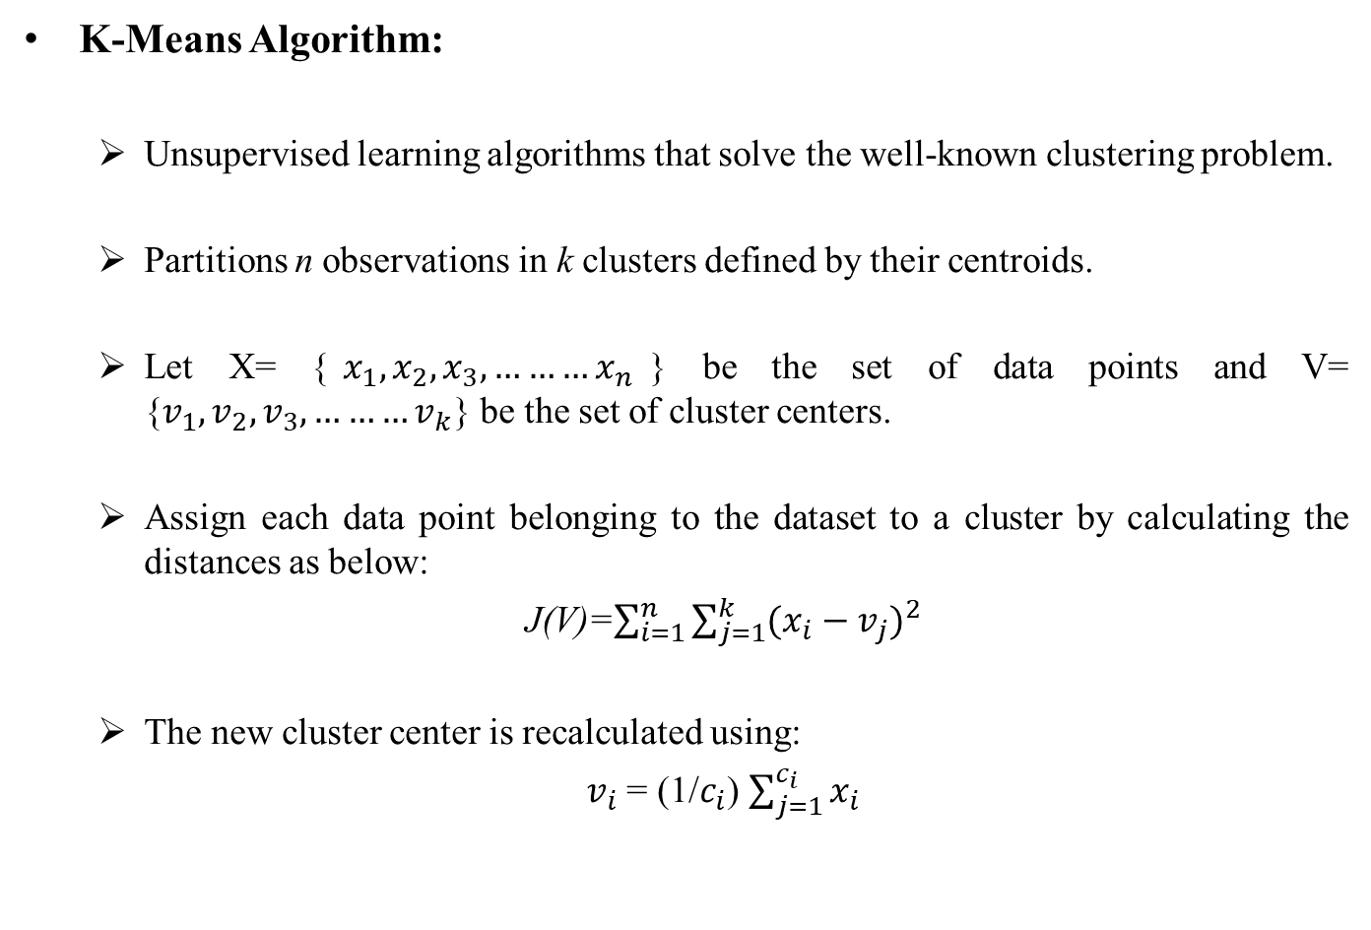
Methodologies Used
K-Means Algorithm:
Unsupervised learning algorithms that solve the well-known clustering problem.
Partitions n observations in k clusters defined by their centroids.
Let X= {$x_{1},x_{2},x_{3},………x_{n}$} be the set of data points and V= {$v_{1},v_{2},v_{3},………v_{k}$} be the set of cluster centers.
Assign each data point belonging to the dataset to a cluster by calculating the distances as below:
J(V)=$\sum_{i=1}^{n}{\sum_{j=1}^{k}{{(x_{i}−v_{j})}^{2}}}$
The new cluster center is recalculated using:
$v_{i}$ = (1/$c_{i}$)$\sum_{j=1}^{c_{i}}{x_{i}}$

Slide 7
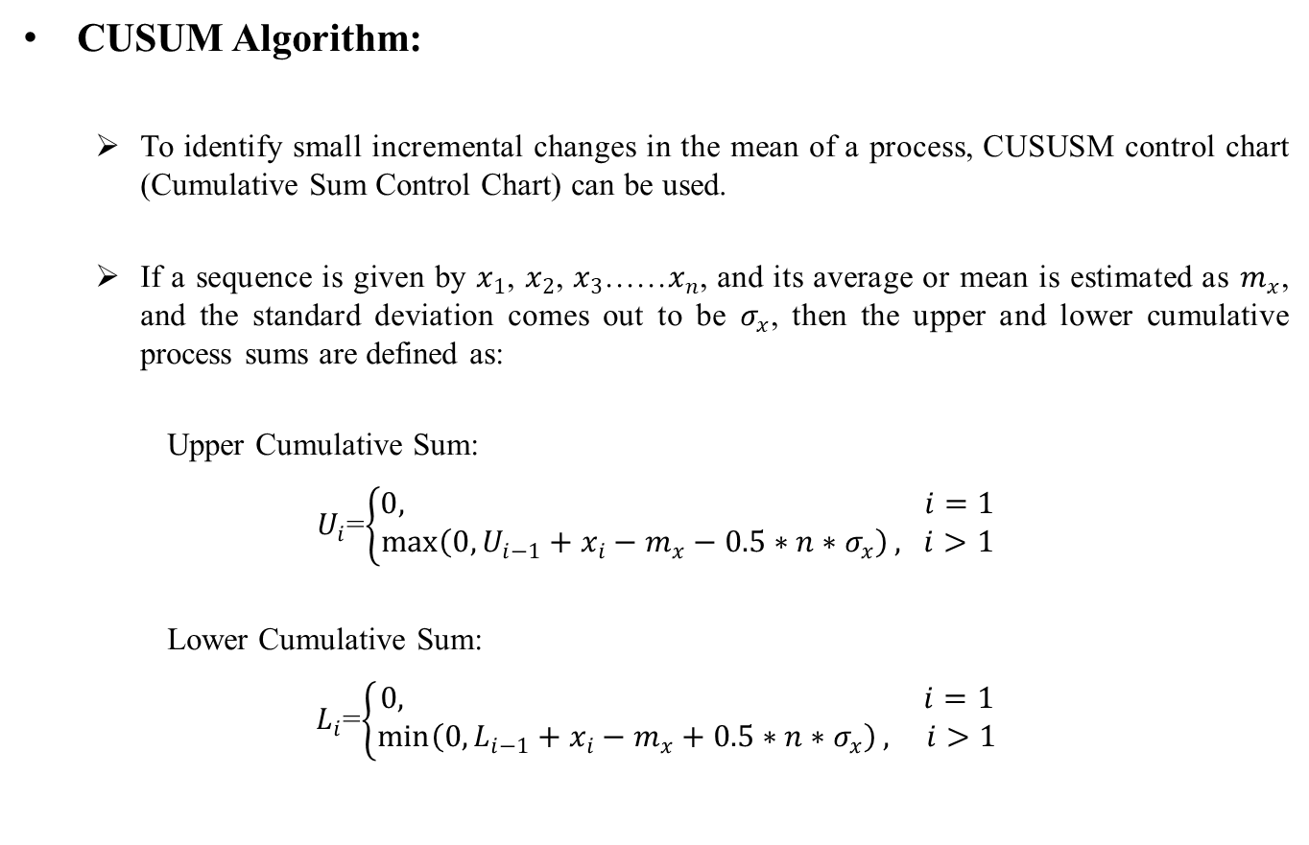
Methodologies Used
CUSUM Algorithm:
To identify small incremental changes in the mean of a process, CUSUSM control chart (Cumulative Sum Control Chart) can be used.
If a sequence is given by $x_{1}$, $x_{2}$, $x_{3}$……$x_{n}$, and its average or mean is estimated as $m_{x}$, and the standard deviation comes out to be $σ_{x}$, then the upper and lower cumulative process sums are defined as:
Upper Cumulative Sum:
$U_{i}$=$\left\{\begin{aligned}0, i=1 \\ \max\left(0,U_{i−1}+x_{i}−m_{x}−0.5∗n∗σ_{x}\right), i>1\end{aligned}\right.$
Lower Cumulative Sum:
$L_{i}$=$\left\{\begin{aligned}0, i=1 \\ \min\left(0,L_{i−1}+x_{i}−m_{x}+0.5∗n∗σ_{x}\right), i>1\end{aligned}\right.$

Slide 8
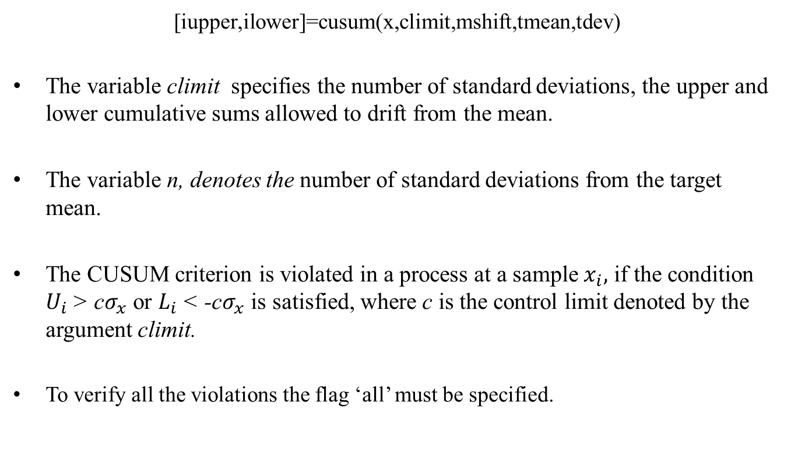
Methodologies Used
[iupper,ilower]=cusum(x,climit,mshift,tmean,tdev)
The variable climit specifies the number of standard deviations, the upper and lower cumulative sums allowed to drift from the mean.
The variable n, denotes the number of standard deviations from the target mean.
The CUSUM criterion is violated in a process at a sample $x_{i},$ if the condition $U_{i}$> c$σ_{x}$ or $L_{i}$< -c$σ_{x}$ is satisfied, where c is the control limit denoted by the argument climit.
To verify all the violations the flag ‘all’ must be specified.

Slide 9
Implementation And Results
15 VOC’s having few results above health benchmark consisting 1462 samples are considered for this work.
Using the health benchmark as the threshold, we have segregated these 1462 samples into ones and zeros.
Chemicals with results above health benchmark: 1
Chemicals with results above health benchmark: 0
Applying the thresholding technique to the 1462 samples they are segrgated into, 1225 samples which have values below the health benchmark and the remaining 237 samples having values above them.
The implementation of the methodologies have been performed in MATLAB.

Slide 10
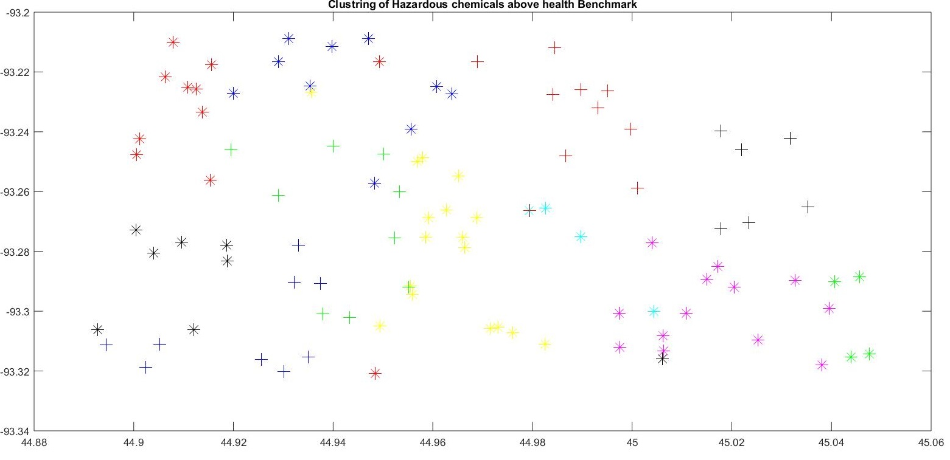
Clustering the area into different zones:
Longitudes, latitudes, postal codes and threshold values are taken as inputs in K-Means clustering algorithm, which generates a plot with eleven clustered regions showing the total number of samples of those fifteen VOCs present in a particular region.

Slide 11
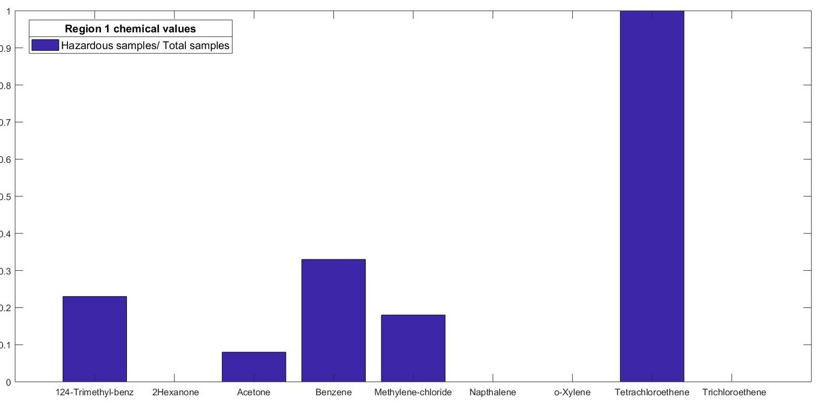
Determining Hazardous chemical in a particular zone
Ratio of number of Hazardous samples and the number of total samples for each chemical present in a particular region are plotted in bar charts as shown below:

Slide 12
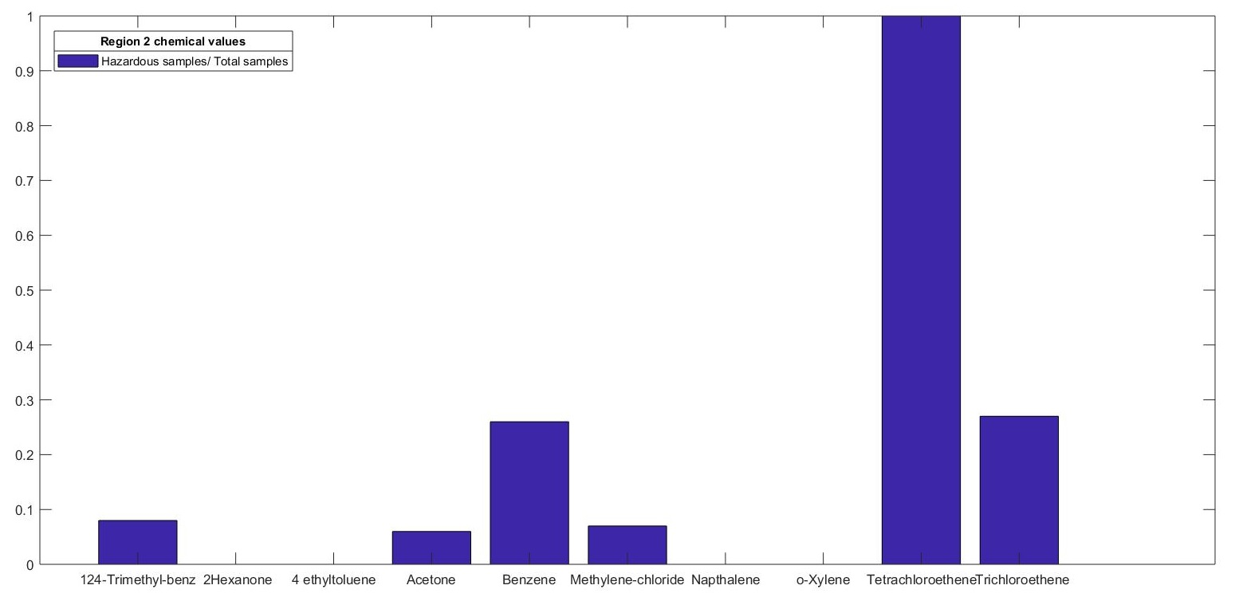
Determining Hazardous chemical in a particular zone
Figure above shows a bar chart of the different chemicals present in region 2, whose values are above the health benchmark. It is evident from the chart that the chemical Tetrachloroethene is present in an anomalous proportion compared to other hazardous chemicals present in the area.

Slide 13
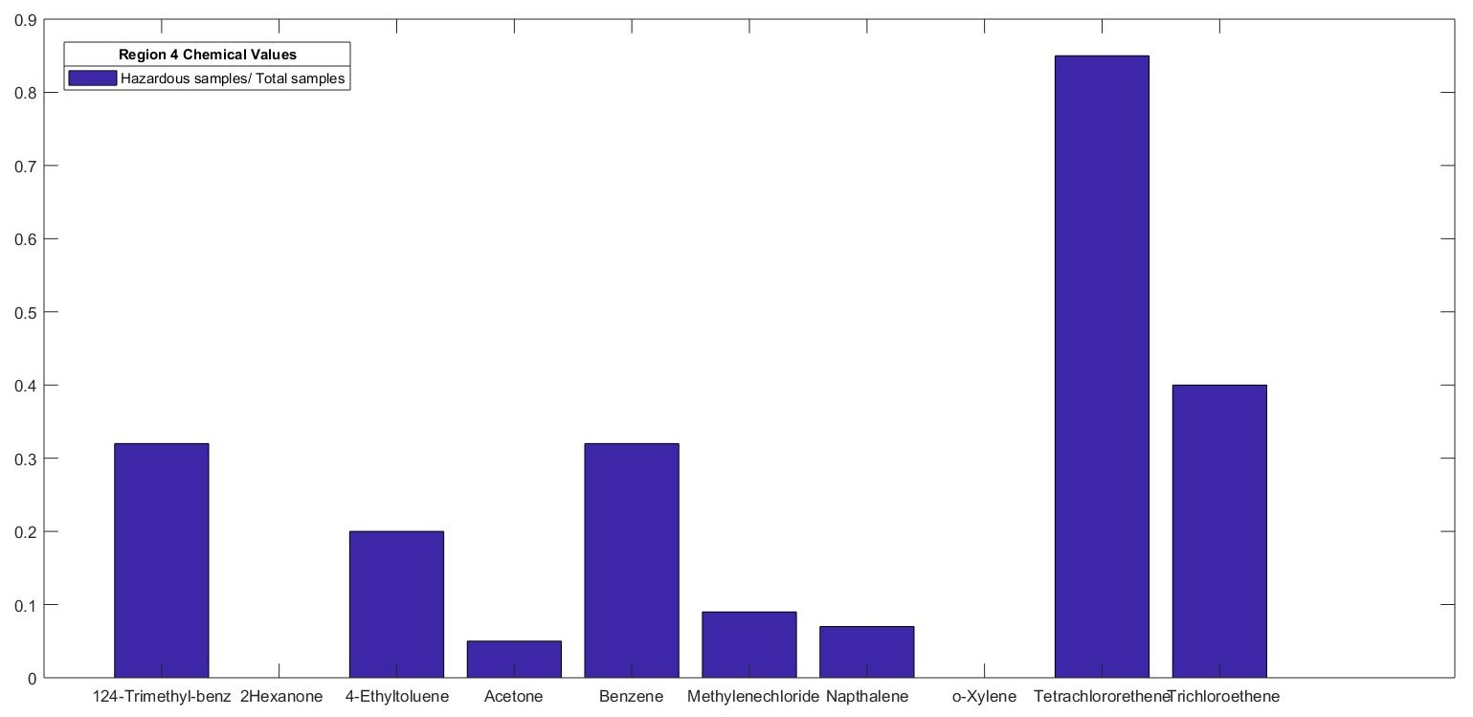
Determining Hazardous chemical in a particular zone
Figure shows a bar chart of the different chemicals present in region 4, whose values are above the health benchmark. It is evident from the chart that the chemical Tetrachloroethene is present in an anomalous proportion compared to other hazardous chemicals present in the area.

Slide 14
Detection of faulty Sensors:
From the first part we have seen the anomalous chemical readings from different zones. It would be interesting to find out the faulty sensor providing the erroneous results.
So, using the CUSUM algorithm we will exactly track the street in which the faulty sensor node was placed.
The theory for CUSUM algorithm was discussed previously, which uses a detection threshold to determine the faulty readings.
Here, as the detection threshold, we vary the standard deviation for every chemical reading to determine the anomalous sensor reading.

Slide 15
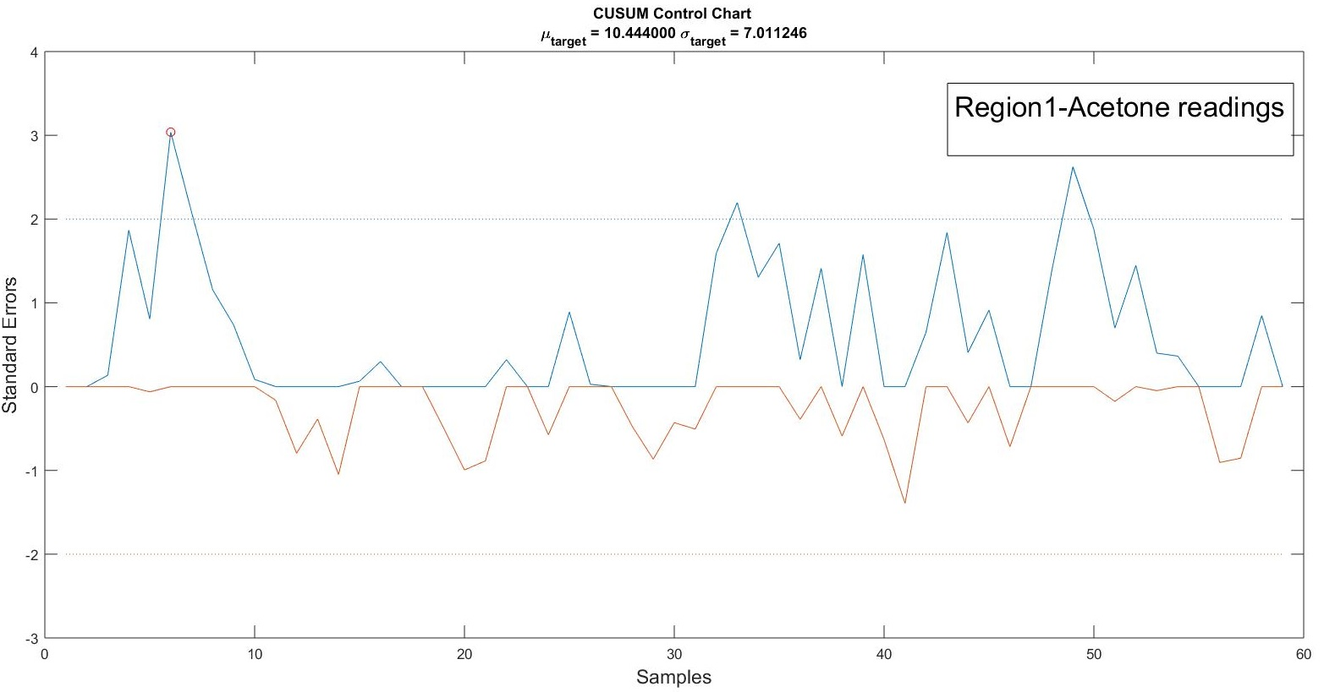
Faulty Sensors in Region 1
The figure above denotes that there are three faulty sensors in region 1 showing the anomalous acetone readings above the threshold of predefined standard deviation. The faulty sensors in region 1, corresponding to these three readings are placed in 2344 River Pointe Circle, 3419 4th St N and 4242 Webber Parkway.

Slide 16
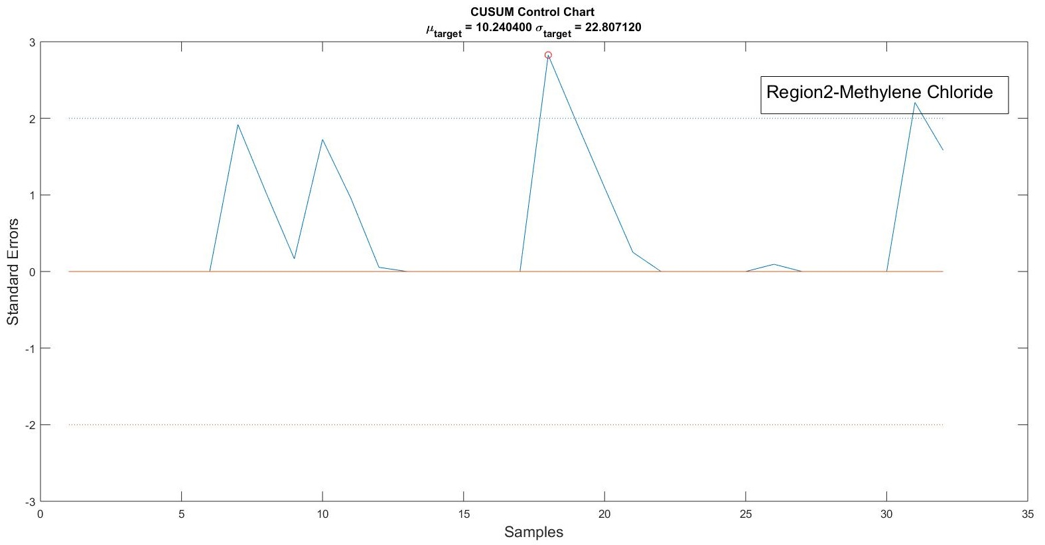
Faulty Sensors in Region 2
The figure above denotes that there are two faulty sensors in region 2 showing the anomalous Methylene Chloride readings above the threshold of predefined standard deviation. The faulty sensors corresponding to these two readings are placed in 3712 Snelling Ave and 502 24th St E.

Slide 17
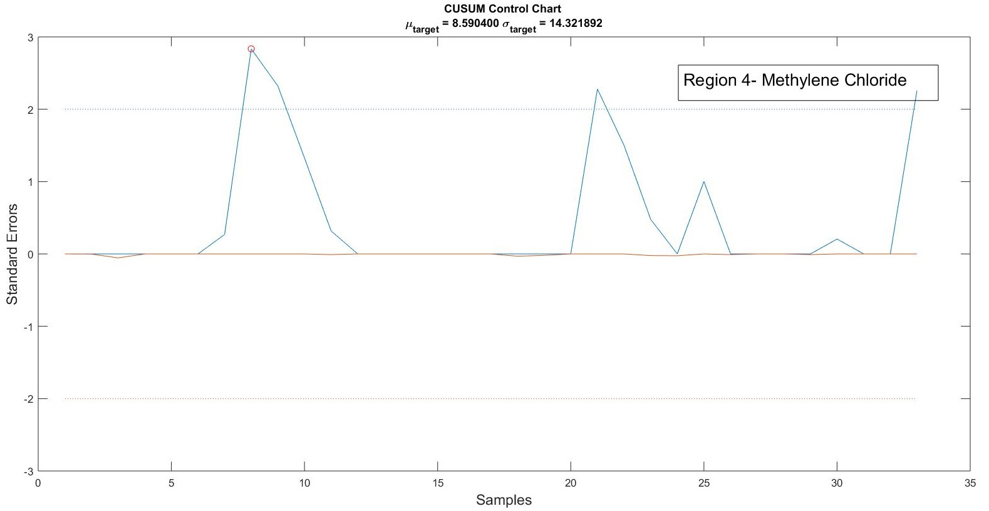
Faulty Sensors in Region 4
The figure above denotes that there are three faulty sensors in region 4 showing the anomalous Methylene Chloride readings above the threshold of predefined standard deviation. The faulty sensors corresponding to these three readings are placed in 3118 Lake St W, 5157 Oakland Ave S and 5615 21st Ave.

Slide 18
Conclusion
First part we apply K-Means clustering technique to cluster the entire city of Minneapolis into eleven different zones and then determine the hazardous chemical in each zone.
Second part of the work we applied a statistical quality control chart called CUSUM for detection of faulty sensor nodes in a particular zone.
Applying the techniques of K-Means clustering and CUSUM algorithm we could successfully determine the anomaly in our dataset.

Slide 19
Future Work
Few improvements that could be applied as an enhancement to this work are:
Implementing an algorithm to fix the detection threshold for our CUSUM algorithm. This observation was due to the simple reason that we had to manually fix the threshold value for different zones and every chemical.
We could get better results on clustering if we could apply the improvisations of K-means algorithm rather than a simple K-means clustering. We had a tradeoff, when we had to cluster the city into different zones, the clustering area was significantly changing with the clustering number.

Slide 20
References
[1] Chandola, V., Banerjee, A., and Kumar, V. 2009. Anomaly detection: A survey. ACM Comput. Surv. 41, 3, Article 15 (July 2009), 58 pages.
[2] Amin Ghafouri, Aron Laszka, Abhishek Dubey, and Xenofon Koutsoukos. 2017. Optimal Detection of Faulty Trac Sensors Used in Route Planning. In Proceedings of the 2nd Workshop on Science ofSmart City Operations and Platforms Engineering, Piˆsburgh, PA USA, April 2017 (SCOPE 2017), 6 pages.
[3] Air quality: A neighborhood approach report.
[4] ES Page. 1954. Continuous inspection schemes. Biometrika 41, 1/2 (1954),100–115

